Slide 1
Supply Chain Climate Exposure
Greg Hall AQR Capital Management
Kate Liu AQR Capital Management
Lukasz Pomorski AQR Capital Management
Laura Serban
AQR Capital Management
Presented by Austin Francis

Slide 2
Research Question
How can we better measure a company's exposure to climate-related risks from its supply chain?
Notes:
The authors argue that a "green" company might still face significant climate risks if its customers or suppliers are heavily involved in carbon-intensive activities
This paper introduces a new way to measure a company's climate risk by considering the climate exposures of its customers and suppliers

Slide 3
Prior Literature
Supply chain relationships have a demonstrated impact on stock returns. Research has shown that the financial performance of companies is closely tied to the performance of their suppliers and customers. This suggests that a company's climate risk could be influenced by the climate exposures of its supply chain partners.
Traditional climate metrics, particularly Scope 3 emissions data, have proven unreliable and difficult to compare across companies. The lack of consistent and high-quality Scope 3 data makes it challenging for investors to accurately assess a company's full climate risk.
"Emissions offshoring", where companies shift carbon-intensive activities to their suppliers, can create a misleading picture of a company's true environmental performance. This practice underscores the need for climate risk assessments that look beyond a company's direct emissions and consider the entire supply chain.

Slide 4
Hypothesis
A firm's climate exposure is impacted by the climate risks associated with its supply chain, and accounting for these linkages provides a more accurate and useful measure of climate risk.

Slide 5
New Measure
The proposed method measures supply chain climate exposure as a weighted average of the standalone climate exposures of a company's customers and suppliers.
The weighting is based on the strength of the economic connections, using revenue weights for customers ("downstream") and cost weights for suppliers ("upstream").
The measure can incorporate any preferred climate exposure metric, such as carbon emissions intensity, climate Value at Risk (VaR), or Implied Temperature Rise scores, offering flexibility in assessing climate risk.

Slide 6
Results
The proposed measure has low but significant correlations with traditional climate data, suggesting it captures unique aspects of climate risk.
This metric better predicts stock price reactions to climate news and reflects performance patterns associated with climate risk repricing.
Portfolios constructed with this new metric have shown positive historical performance, suggesting that market participants may already be pricing in supply chain climate risks.

Slide 7
Data Collection
The authors use data on the commercial linkages between companies and their customers, blending data from multiple third-party vendors that track global supply chains using regulatory filings, earnings transcripts, company and industry publications, and news sources.
The study utilizes scope 1+2 carbon intensity of customers and suppliers as reported in the Trucost database to measure a customer's or supplier's climate exposure.
The authors obtained standard returns and financials data from Xpressfeed and a variety of ESG-related metrics from MSCI and Trucost.

Slide 8
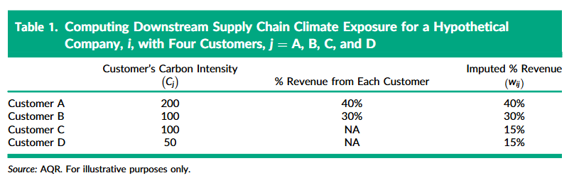
Notes:
This table shows how the climate exposure is calculated. A sum of downstream customers carbon intensity weighted by revenue.

Slide 9
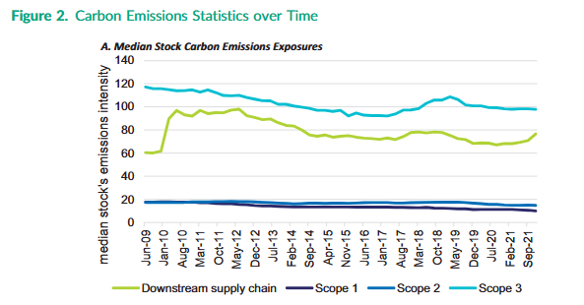
Notes:
X axis = Time y axis = Carbon emissions intensity Downstream = Authors new measure scope 1 = direct from sources they control scope 2 = energy a company buys
Scope 3 = all indirect emissions from a company’s supply chain

Slide 10
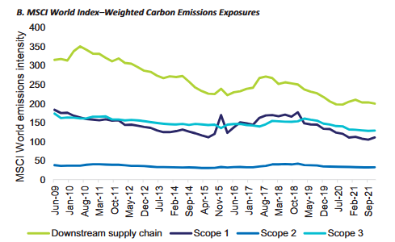
Notes:
Weighted average intensity for the entire MSCI world index.

Slide 11
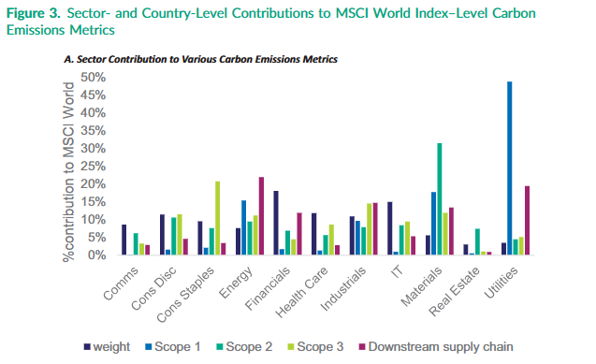

Slide 12
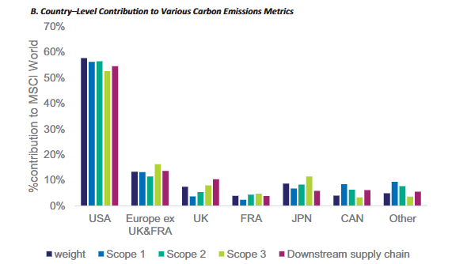

Slide 13
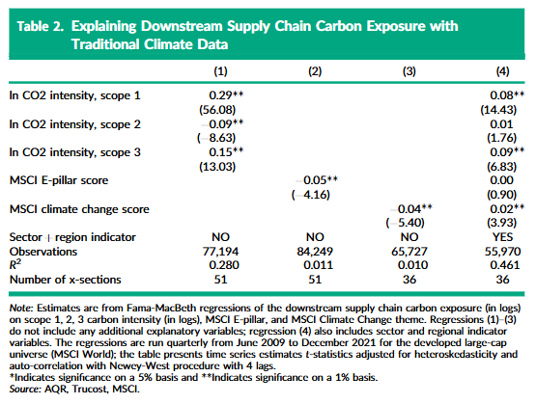
Notes:
Regressing the new metric on old scopes and MSCI Key Takeaways:
●
Correlation with traditional data: The downstream supply chain climate exposure measure exhibits statistically significant correlations with established climate data, including scope 1 and 3 emissions intensity and MSCI ESG scores.12
●
Limited explanatory power: While traditional climate data shows some relationship with downstream supply chain exposure, these variables only explain a relatively small proportion of the variability, with R-squared values ranging from 1% to 30%.3
●
Incremental information: This suggests that the downstream supply chain climate exposure measure captures unique information about climate risk that goes beyond what is already incorporated in traditional climate metrics.4

Slide 14
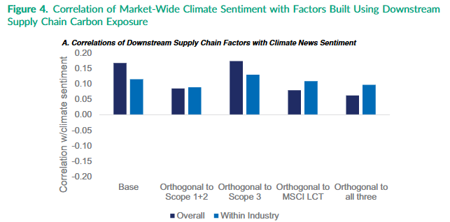
Notes:
The top panel shows monthly return correlations with the monthly changes in climate news sentiment index of Ardia et al.(2021) for factors based on downstream supply chain climate exposure overall and within-industry exposure as well as after remov-ing the commonality with other typical climate-related data.
how well the factors correlate with climate news sentiment when removing other measure of climate change

Slide 15
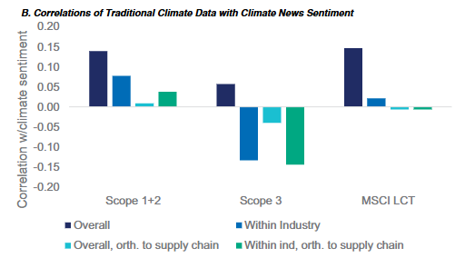
Notes:
The bottom panel shows similar correlations for a hypothetical long-short portfolio based on typical climate-related data, removing the commonality with the downstream supply chain measure, as indi-cated in the chart.

Slide 16
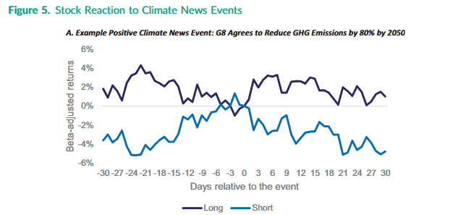
Notes:
Loosely follows what you would expect

Slide 17
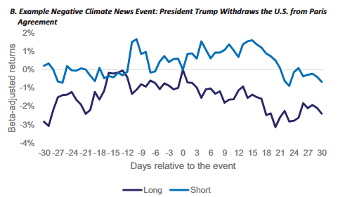

Slide 18
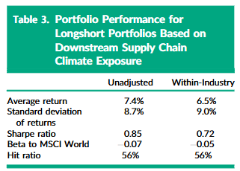
Notes:
Both portfolios perform well, with the unadjusted one having a slightly higher Sharpe ratio (0.85 vs. 0.72). This means that even without controlling for industry, companies with lower "customer pollution" tend to do better.
●
Strong performance: Portfolios long in "green" stocks and short in "brown" stocks, based on the downstream supply chain climate exposure measure, exhibit compelling historical performance with Sharpe ratios of 0.85 and 0.72 for unadjusted and within-industry portfolios, respectively.5
●
Not driven by sector bets: The performance persists even when industry exposures are neutralized, indicating that the returns are not simply a result of broad sector allocations (e.g., shorting Energy and going long IT).5
●
Market pricing of climate risk: This performance is consistent with the idea that markets are increasingly incorporating climate risks into asset prices, potentially leading to the outperformance of companies with lower downstream supply chain climate exposure.

Slide 19
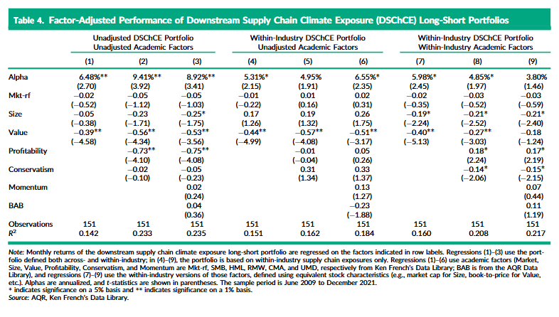
Notes:
Monthly returns are regressed on the factors indicated in row labels. Key Takeaways:
●
Unexplained performance: The downstream supply chain climate exposure portfolio consistently demonstrates positive alphas ranging from 6.5% to 9.4% per year when regressed against standard academic risk factors, even after controlling for industry exposures.78
●
Robust to factor adjustments: The performance persists even when using more conservative factor definitions that specifically account for the portfolio's within-industry construction and stock universe.910
●
Potential new source of alpha: This suggests that the downstream supply chain climate exposure measure may represent a novel source of investment alpha that is not captured by traditional risk factors, potentially related to the market's pricing of climate risks or a reflection of the quality of a company's customer base.

Slide 20
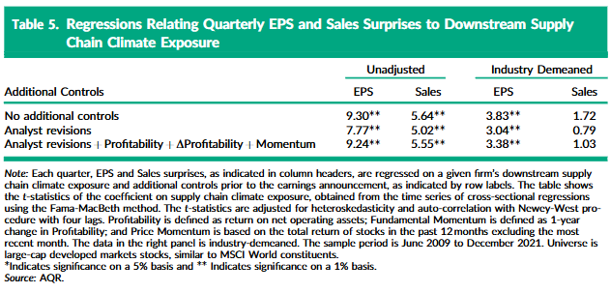
Notes:
EPS and Sales surprises are regressed on a given firm’s downstream supply. Key Takeaways:
●
Predictive of earnings surprises: Companies with lower downstream supply chain climate exposure tend to exhibit larger positive EPS surprises, even after accounting for factors like analyst revisions and various momentum measures.11
●
Potential quality signal: This relationship suggests that the measure may capture a facet of company "Quality," potentially related to resource efficiency or the stability of a company's customer relationships.11
●
Consistent with performance: The positive association with earnings surprises provides a potential explanation for the strong historical performance observed for portfolios based on the downstream supply chain climate exposure measure, aligning with the idea that quality often translates into favorable investment returns.

Slide 21
Conclusion
A new approach to measuring climate risk: The paper introduces the concept of downstream supply chain climate exposure, which assesses a company's climate risk by considering the carbon intensity of its customers. This approach recognizes that a company with low direct emissions can still be vulnerable to climate change impacts if its customers are heavily exposed.
Offers unique insights beyond traditional metrics: Downstream supply chain climate exposure captures information not fully reflected in traditional climate data like scope 1, 2, and 3 emissions. This is evident in its correlation with climate news sentiment and its ability to explain stock price movements around climate-related events, even after controlling for traditional metrics. It also provides a different sector and geographic perspective on climate risk.
Practical implications for investors and corporations: The measure can be used by investors for portfolio risk management and to potentially enhance investment decisions. For companies, it offers a more relevant and manageable way to assess and report climate risks compared to the often-complex scope 3 emissions data.

